Slide 1
Understanding methane and carbon dioxide emissions in the Mackenzie Delta region
Dr. June Skeeter [they/them/theirs]

Slide 2
Introduction: My Background
I specialize in measuring greenhouse gas (GHG) exchange in permafrost environments.

Slide 3
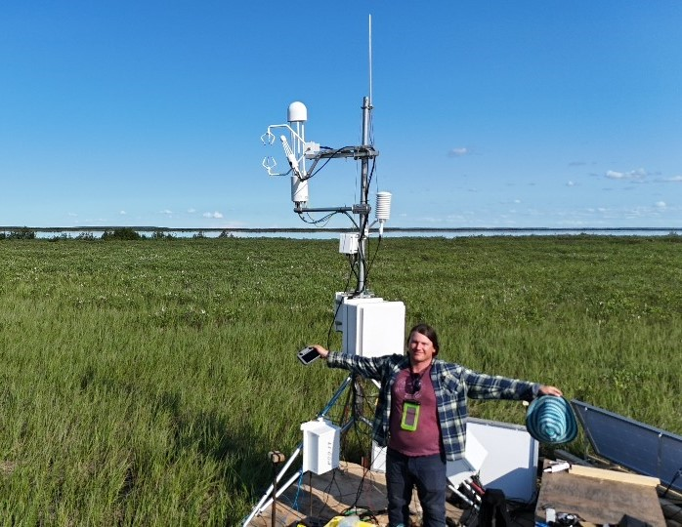
PhD in Geography from UBC in 2023
I started as a research scientists with the GSC in summer 2024
“Cross posted” between GSC Northern and Pacific
2024 Fish Island Field Campaign

Slide 4
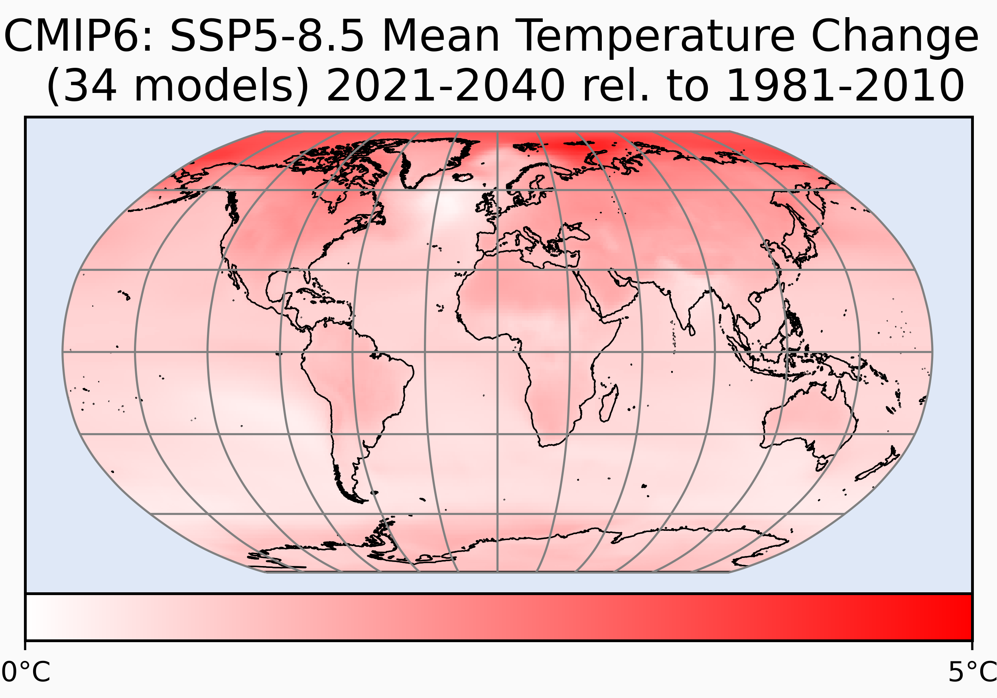
Framing the Problem
The Arctic is warming ~3x faster than the global average.
Image source: Skeeter 2022

Slide 5
Carbon-Climate Feedback
Climate change is shifting the carbon balance of the Arctic, which has far reaching global implications.

Slide 6
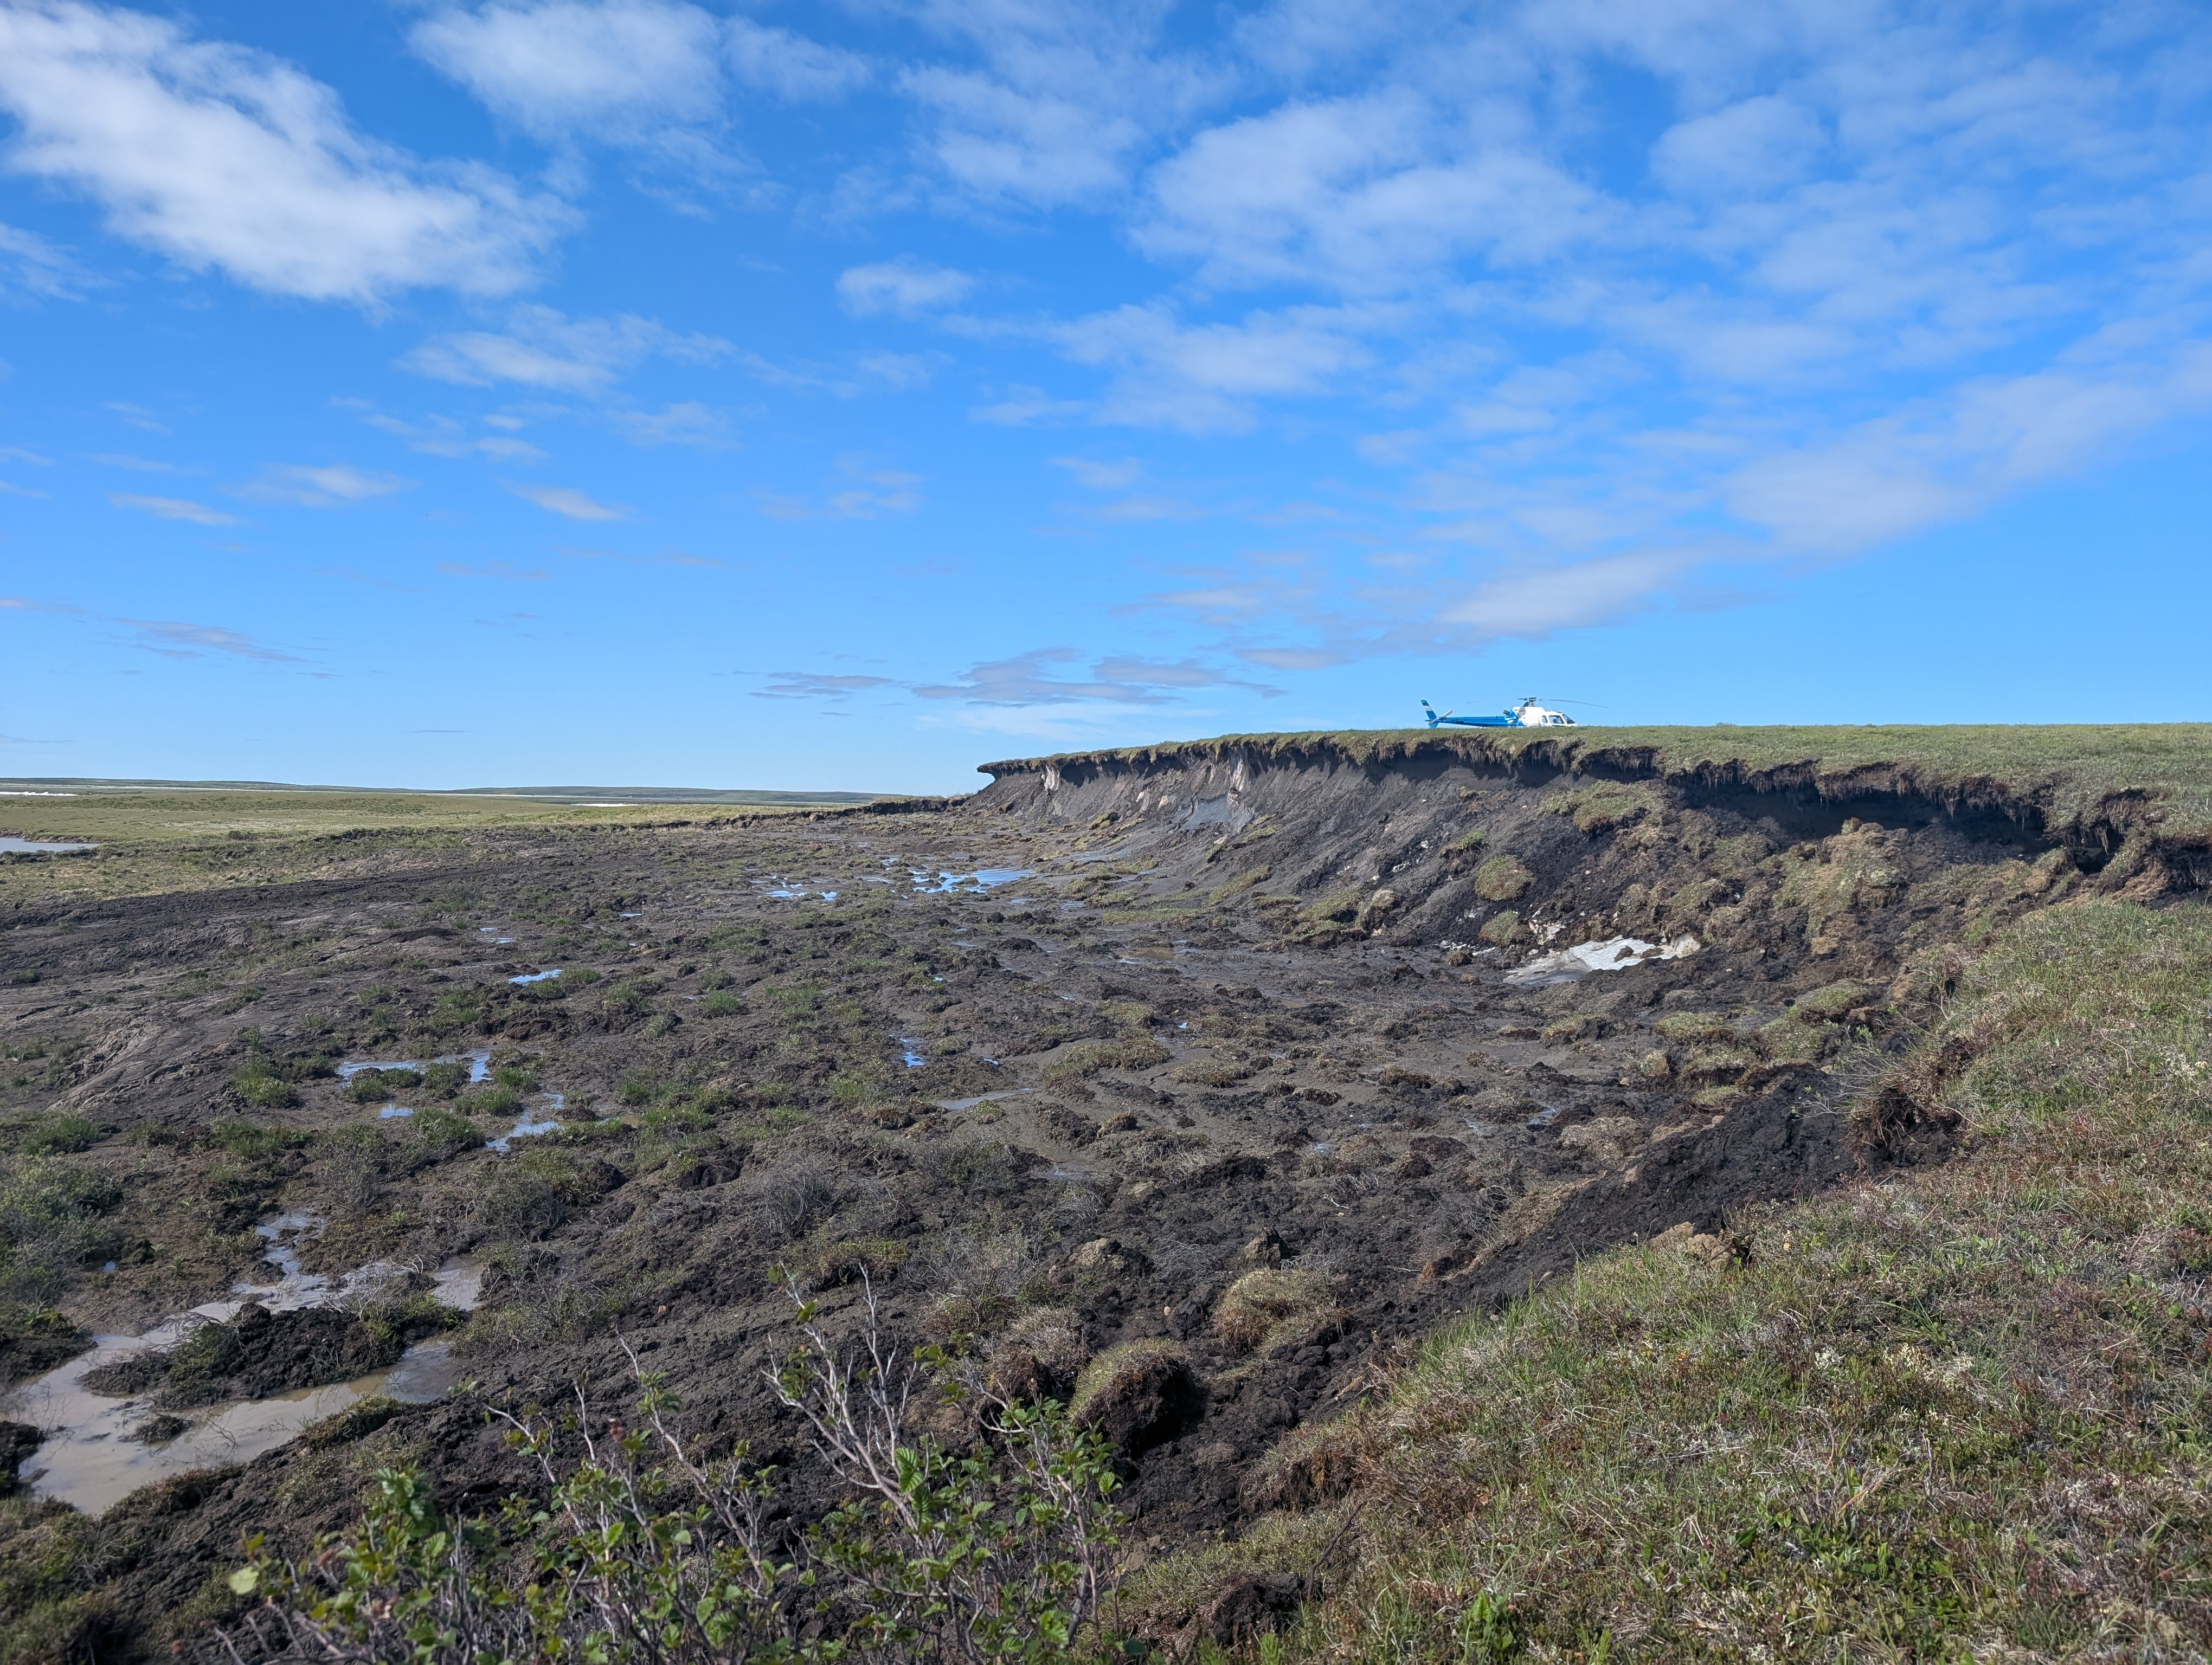
Extended growing seasons
↑ Carbon uptake
Permafrost degradation
↑ Carbon emission
Flooding & coastal erosion
↑ Carbon emission
Niglintgak thaw slump

Slide 7
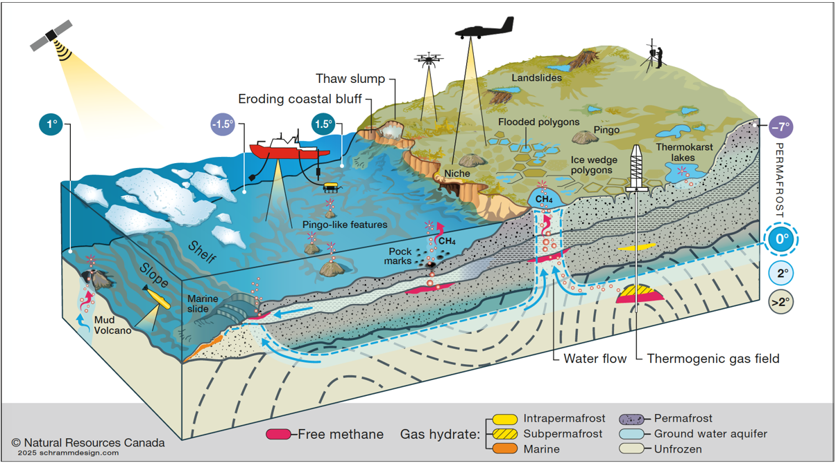
Importance of Methane
Source: GRID-Arendal, 2020

Slide 8
A Methane Hot-spot
The Mackenzie River Delta is hot-spot for methane in the Canadian Arctic. Aircraft and satellite have detected significant methane emissions
Source: Kohnert et al. (2017)

Slide 9
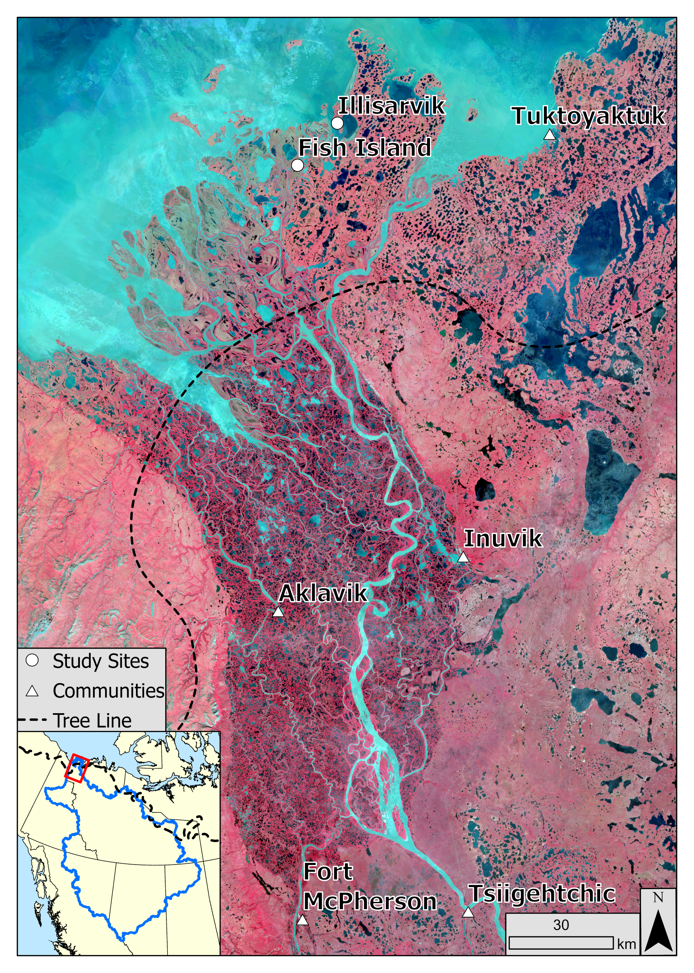
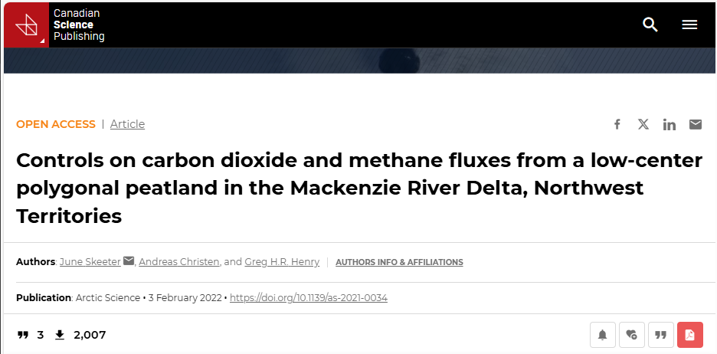
Biologic Emissions
The limited field based measurements available suggest of substantial growing season emissions over where permafrost is continuous.
Source: Skeeter 2023

Slide 10
Geologic Methane
In discontinuous permafrost, some gas seeps are visible to the naked eye!

Slide 11
More work is needed:
Map sources
Quantify emissions
Identify potential remediation strategies

Slide 12
How do we measure emissions?
Eddy covariance (EC) is a principal method to monitor landscape-scale fluxes.

Slide 13
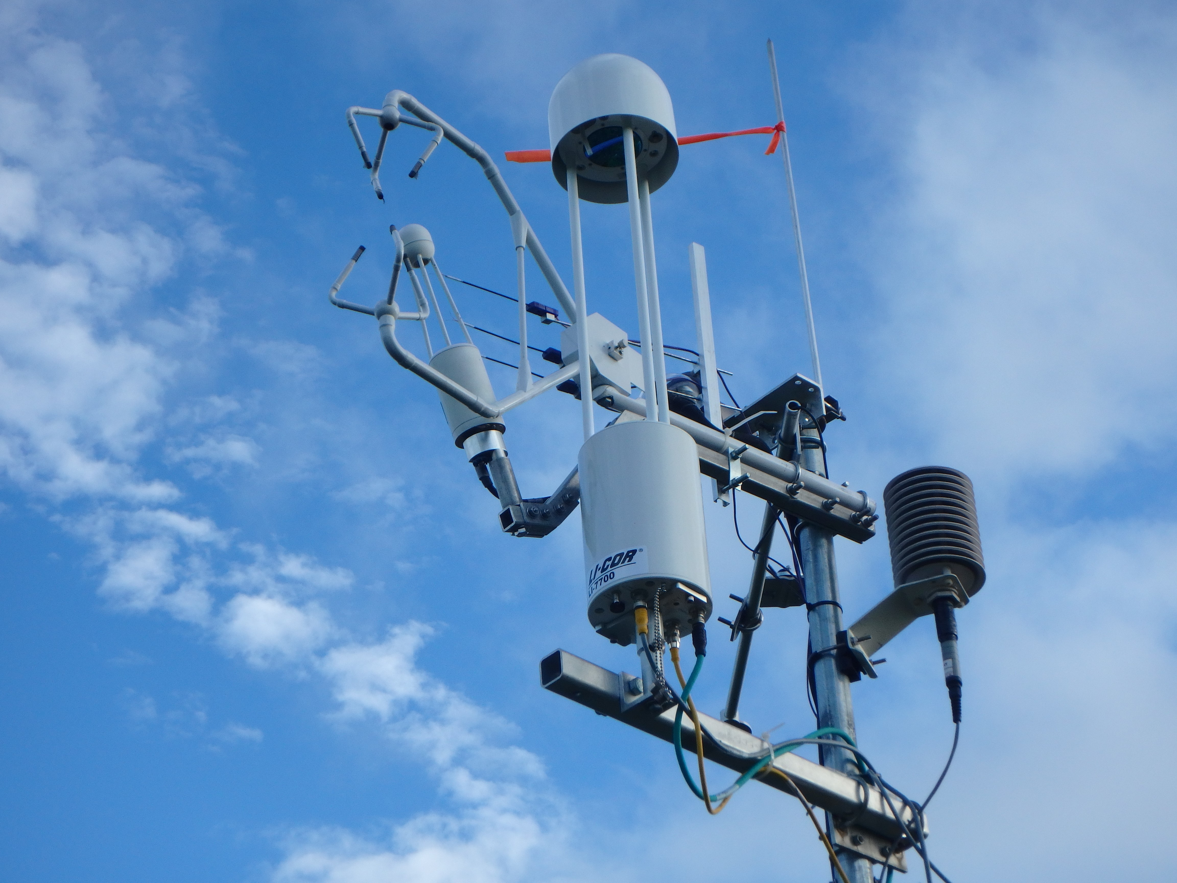
Measures wind velocity and gas concentration at high frequency (20 Hz)
Gives a semi-continuous time series of half-hourly fluxes

Slide 14
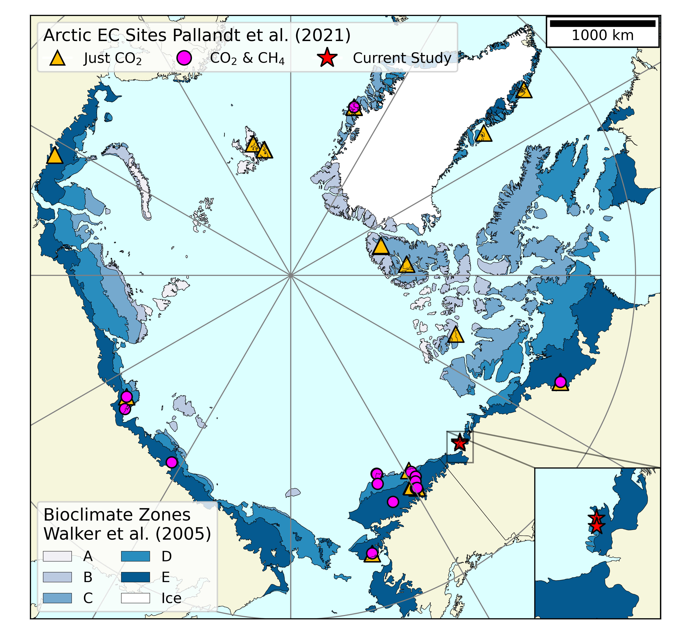
Limited Observations
EC systems are expensive, difficult to operate in remote environments, and require meticulous analysis.
Bias towards accessible sites
Canadian Arctic is under-represented
Source: Skeeter 2023

Slide 15
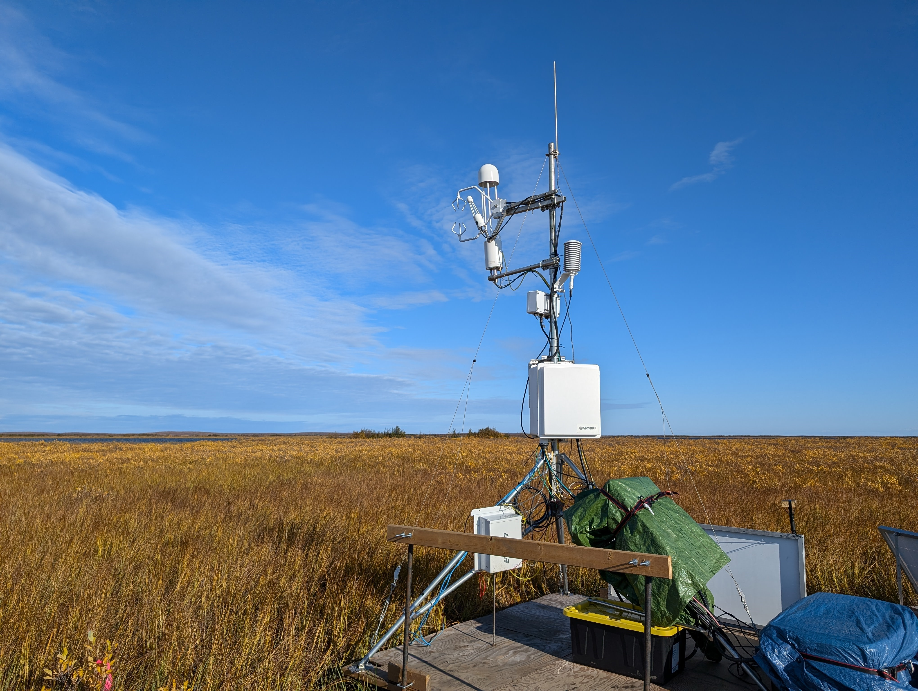
Swiss Cheese Lake
Established in summer 2024 to study the discontinuous permafrost zone.
In a sedge wetland ecosystem “typical” of the outer delta.

Slide 16
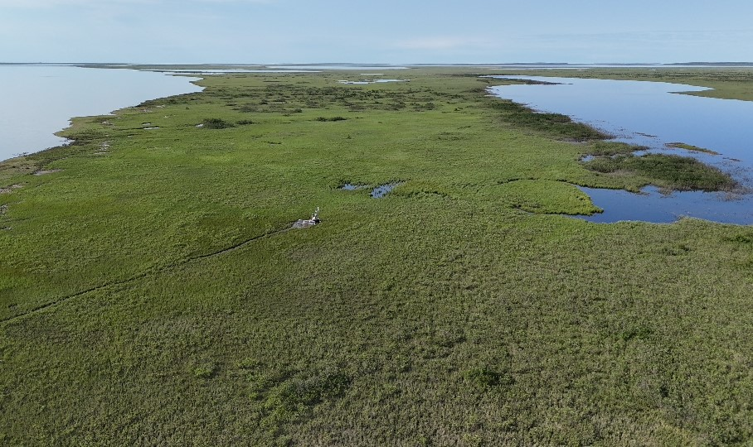
Swiss Cheese Lake
Objective is to help understand emissions associated with biologic production and diffuse geologic sources in discontinuous permafrost.
Understand drivers of emission
Measure non-growing season emissions

Slide 17
Analysis
Eddy covariance produces large volumes of data which are requires complex, computationally expensive processing.
This poses a significant challenge to researchers.
Only ~10% of EC sites in Canada have published open-access datasets.
I am collaborating on an open-source data processing pipeline with other Canadian researchers.

Slide 18
Next steps
Installing upgraded sensors and upgrading the power system to support non-growing season measurements.

Slide 19
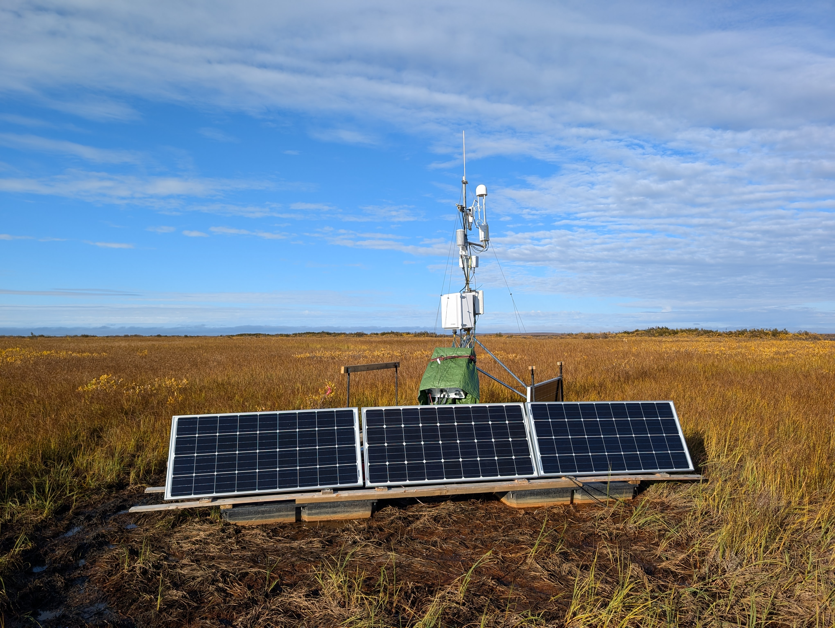
2024 was an exploratory campaign conducted using borrowed sensors.
2025 will be run using GSC sensors.

Slide 20
Further work
Swiss Cheese Lake can serve as an “anchor point” for more spatially targeted investigations.

Slide 21
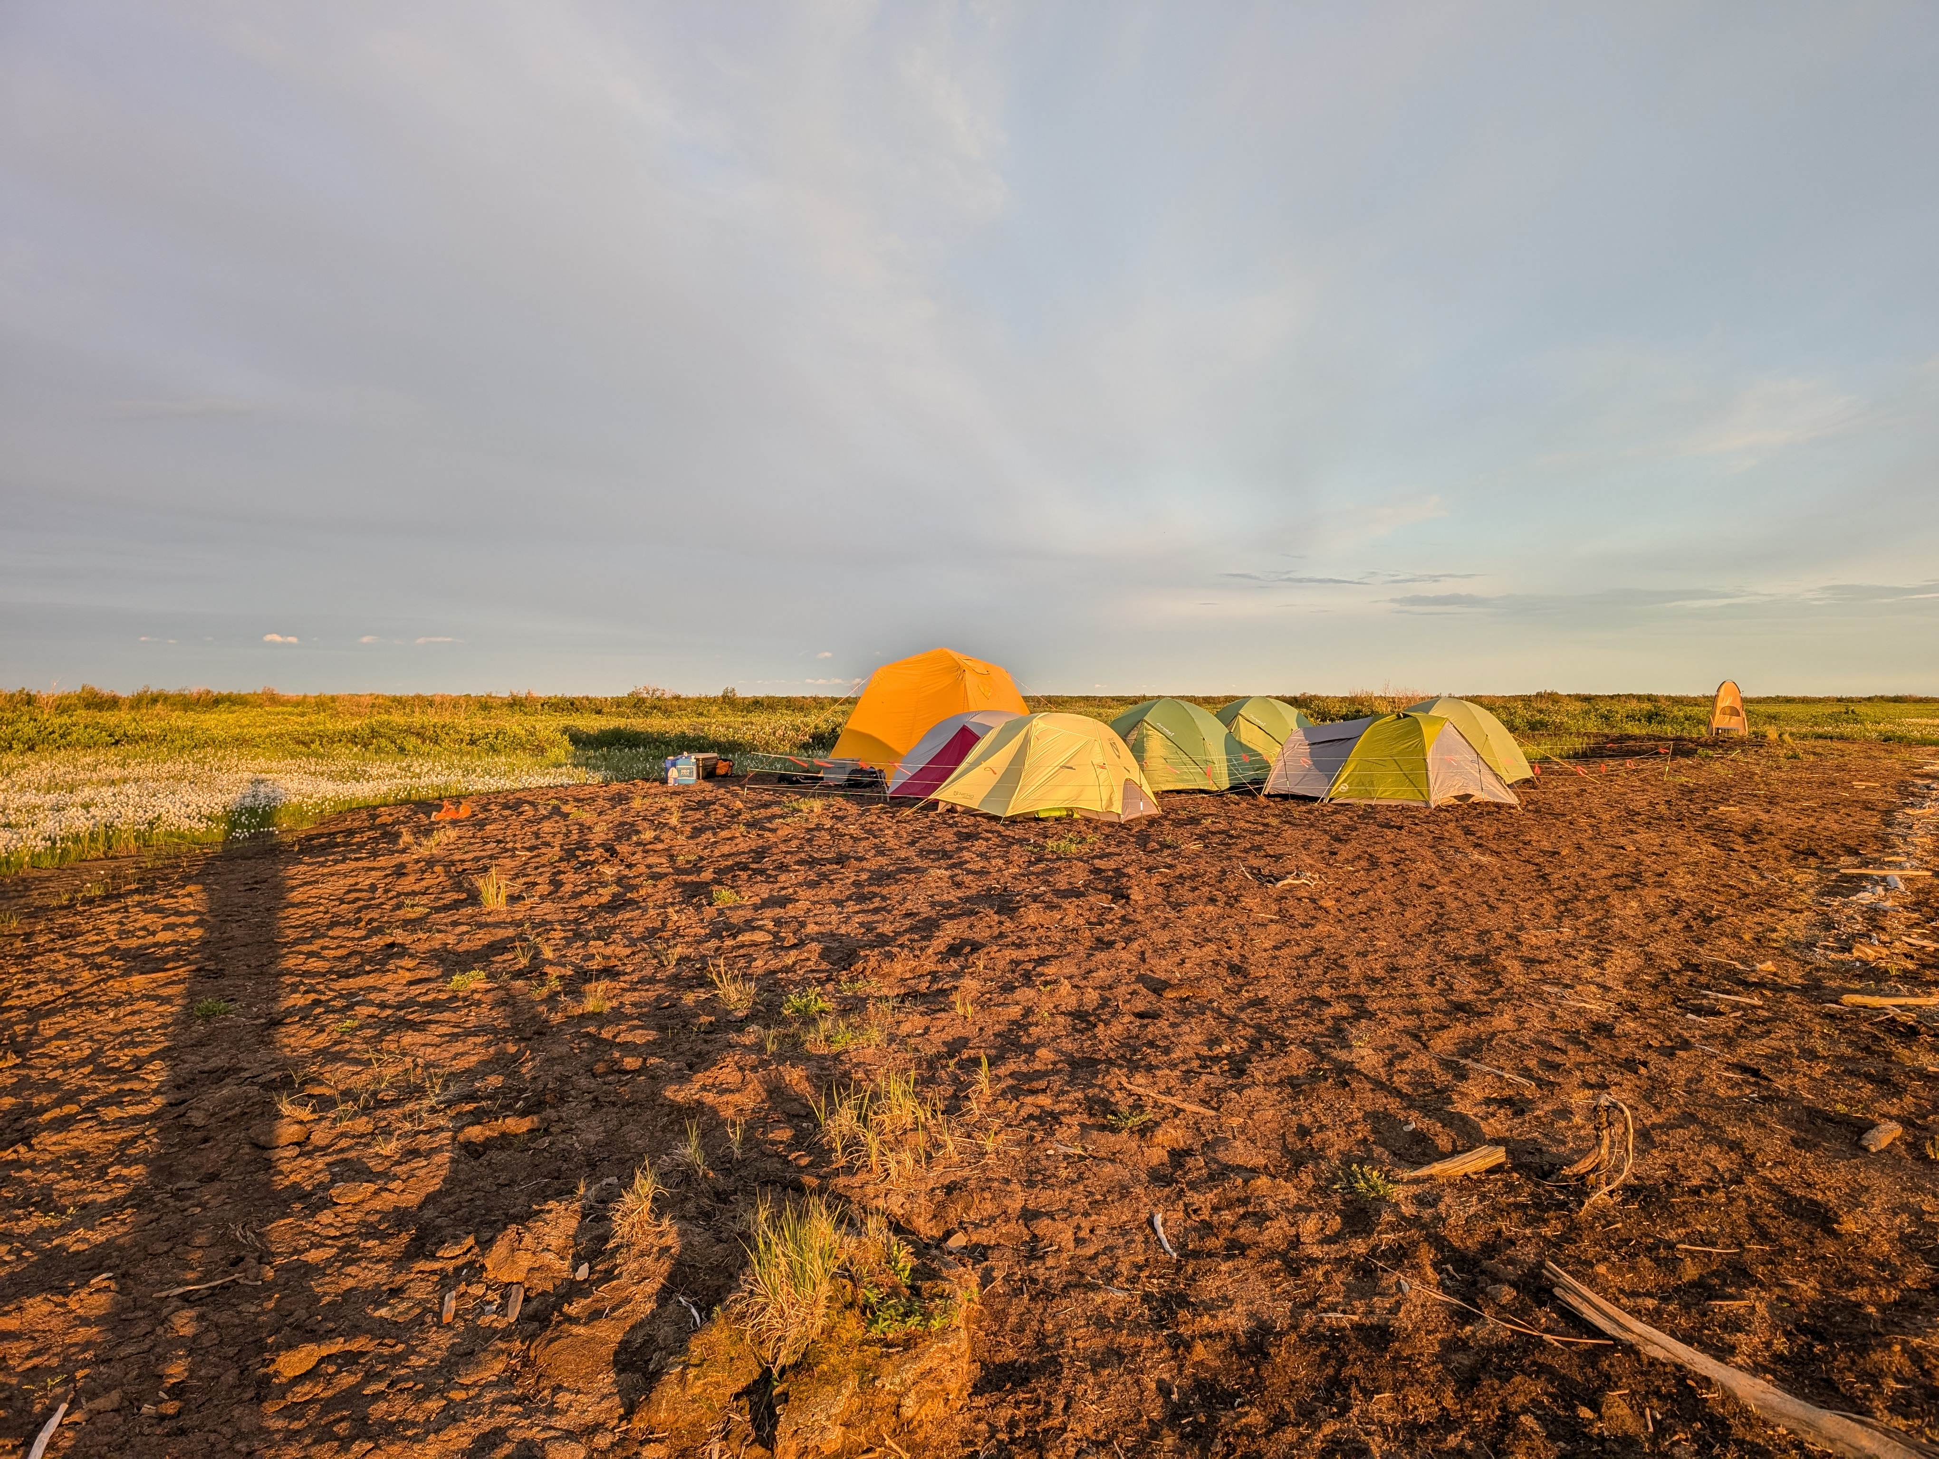
Flux chambers to investigate fine-scale patterns
Use drone to target hot-spots in the surrounding area
Temporary EC systems in natural and disturbed areas

Slide 22
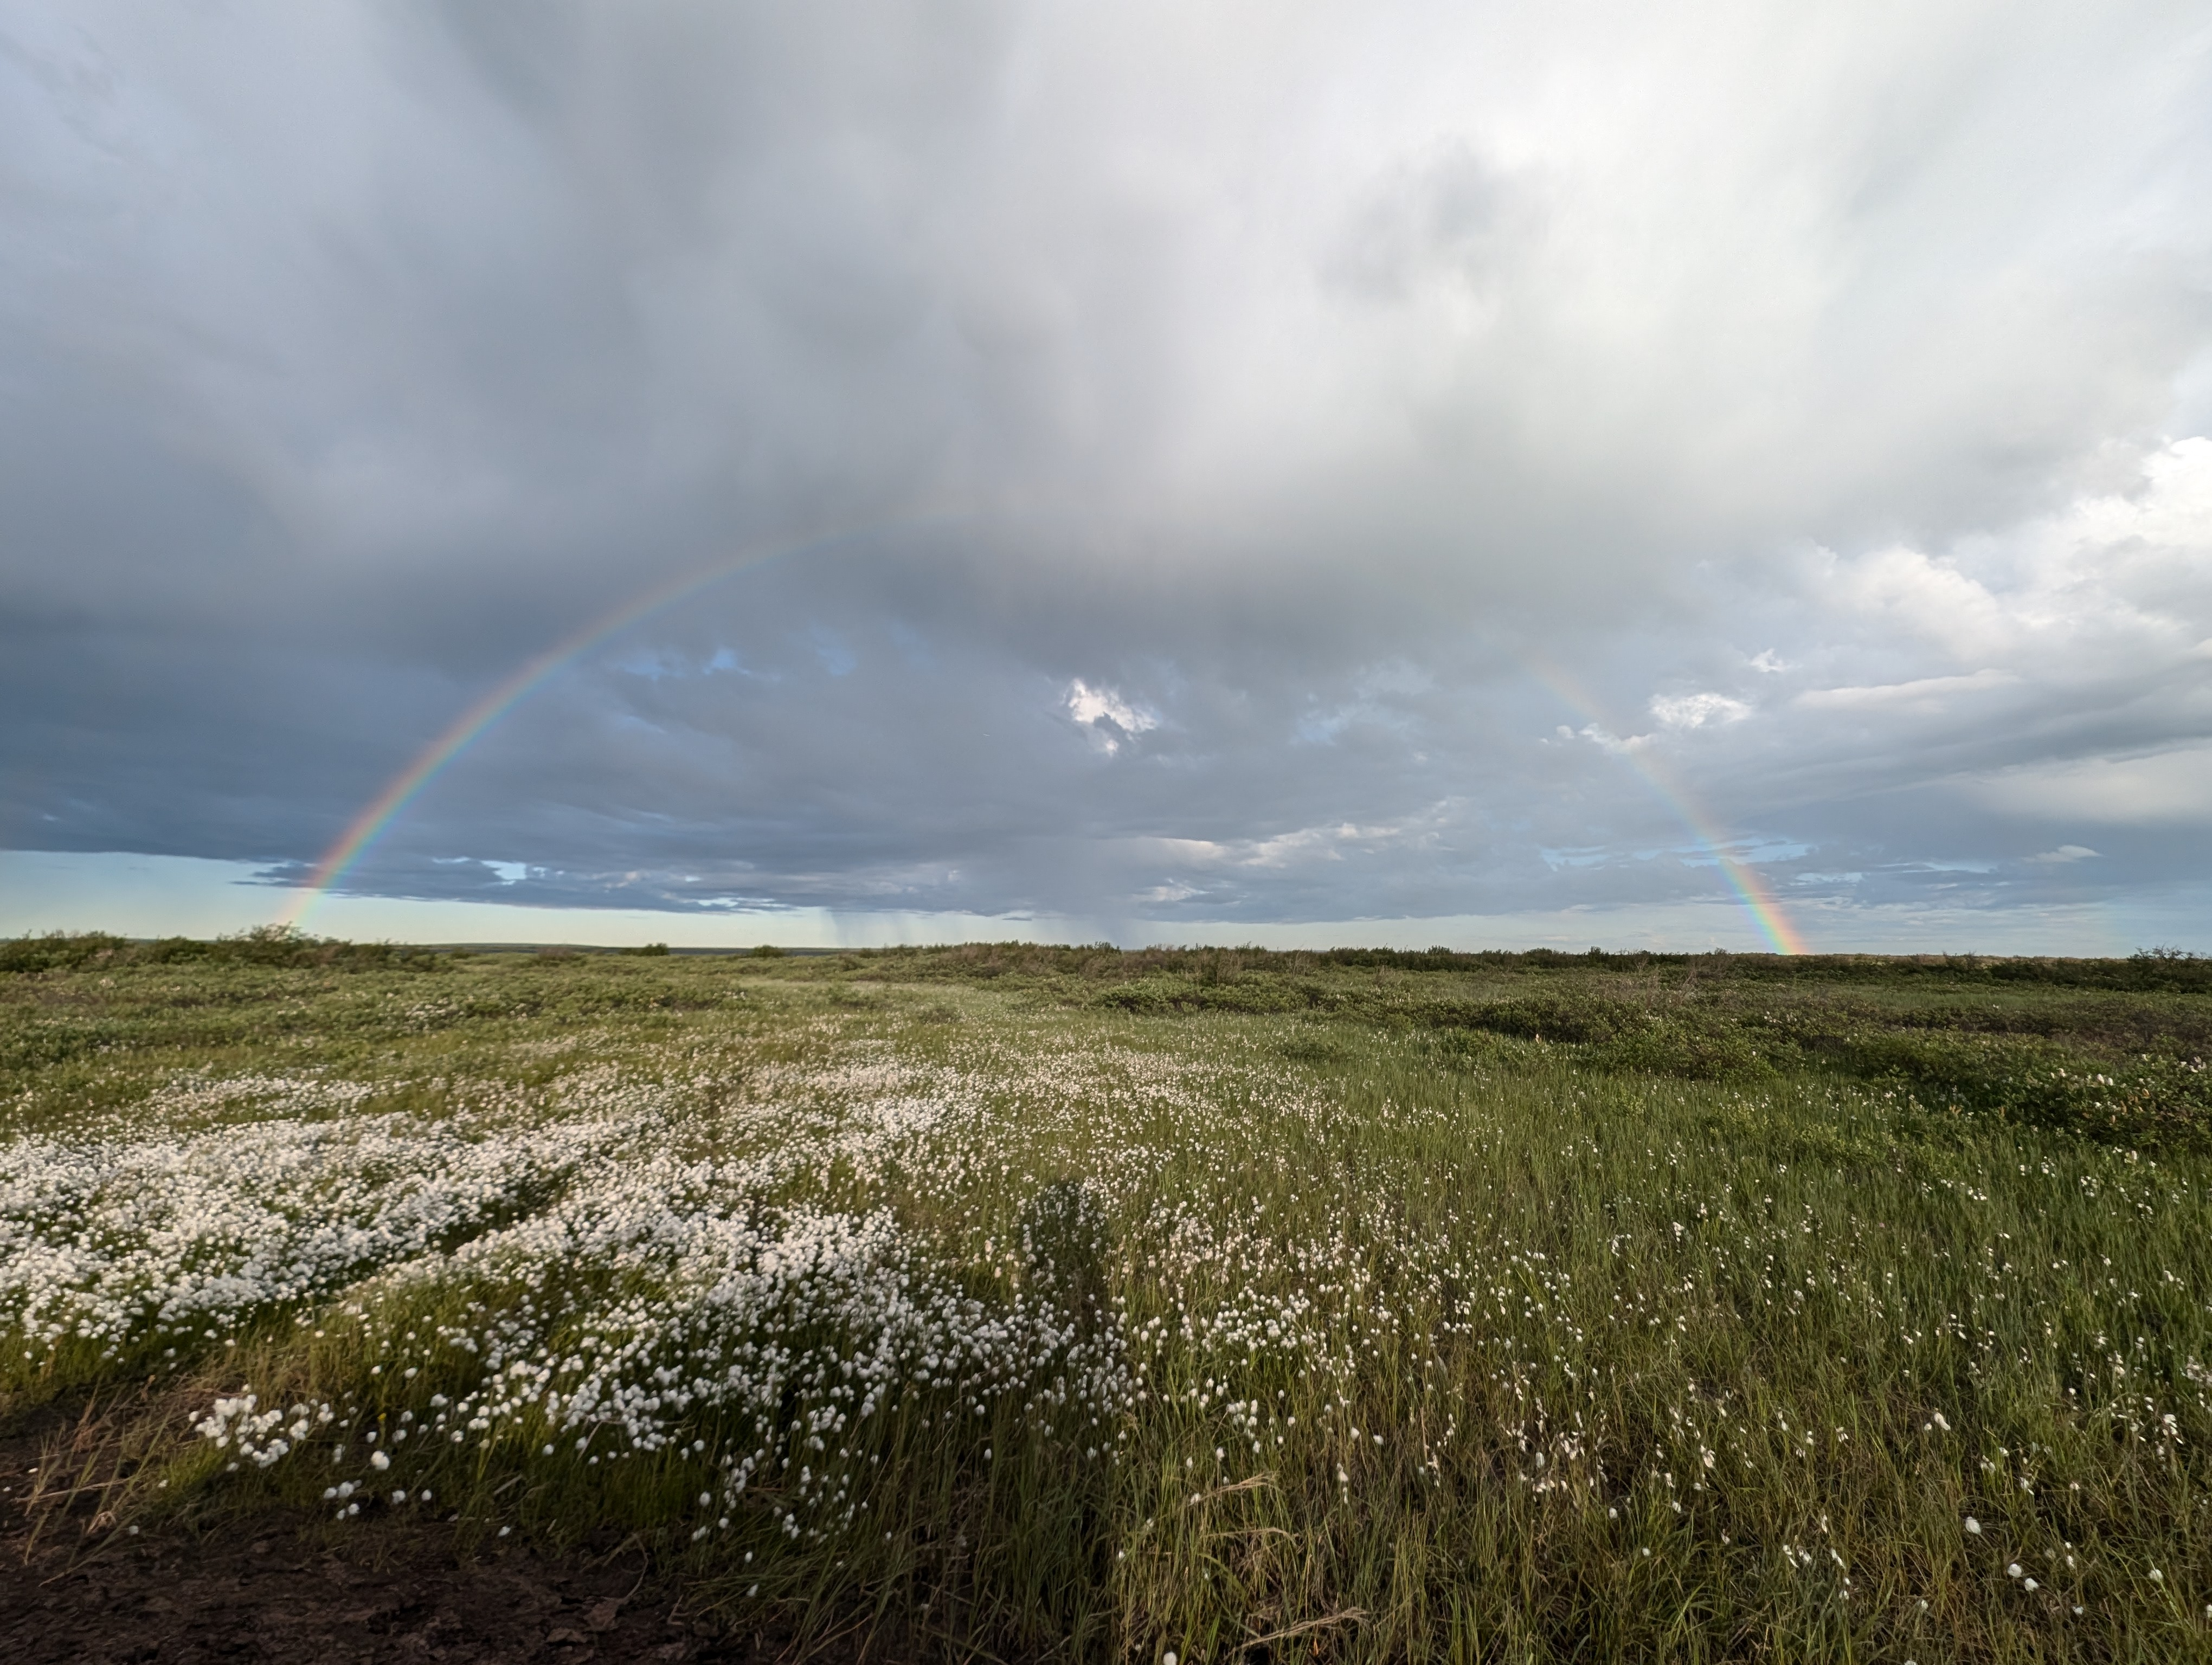
Thank you
Questions?

